Slide 1



STUDENT
DETAILS
Name : Yash Namdev Katkamwar
SkillsBuild Email Id: katkamwaryash1105@gmail.com
College: MGM’s College of Engineering, Nanded
State: Maharastra
Internship Domain : Artificial Intelligence
Internship Start & End Date: 11 Aug 2023 to 3 Oct 2023

Slide 2
Problem
Statement
Sentiment Analysis
of
Restaurant Reviews

Slide 3

AGENDA
Importing Dataset
Preprocessing Dataset Removing stopwords
Training and Classification Analysis Conclusion
Project Link

Slide 4

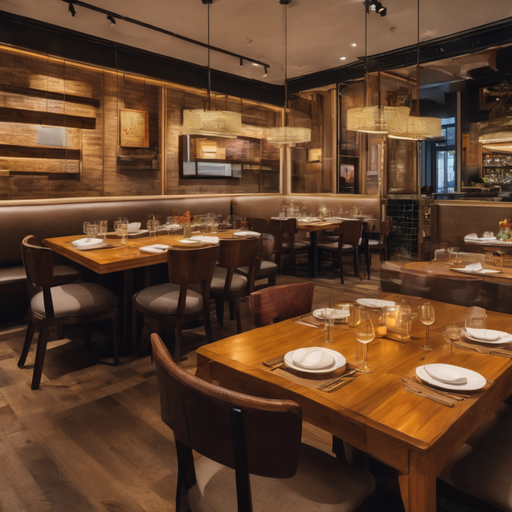
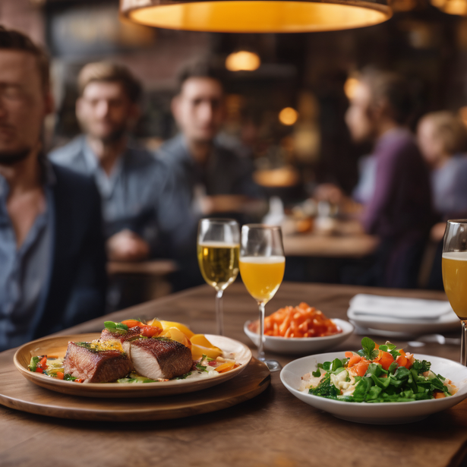
PROJECT
OVERVIEW
The goal of this study is to create a prediction model that can foretell whether a review of the restaurant will be favorable or unfavorable, We'll use the Restaurant Review dataset to accomplish this and load it into the multinomial naive bayes, bernoulli naive bayes, and logistic regression predictive algorithms. In the end, our goal is to identify the "best" model for analysing the sentiment of reviews.

Slide 5

WHO ARE THE
END USERS
Owners/managers of restaurants
- Determine what needs to be improved.
- rely on analysis while making operational decision
- Menus can be changed as needed.
Professionals and Academics
- scientists who study languages
- specialists in psychology
Customers
- Sentiment analysis is advantageous to restaurant patrons.
- Reviewers can read them.
- They view sentiment scores overall.
culinary marketers
- Businesses that conduct market research use sentiment analysis.
- Industry of interest: the dining sector.
- Educate reports and strategic decisions.
Health or government officials

Slide 6
YOUR
SOLUTION
Comprehensive Sentiment Analysis Tool
Create a robust sentiment analysis tool for restaurant reviews.
Designed to handle large volumes of reviews from diverse sources.
Tailored specifically for the restaurant industry.
User-Friendly Interface
Create a web- and mobile-friendly application.
available to restaurant proprietors, patrons, and researchers.
Easy-to-use interface with a clear design.
Competitive Benchmarking
Finding Industry Leaders: Assists in locating the best eateries.
Areas for work: Highlights areas that want work
Trend Identification
Finding emerging trends is the goal.
Focus areas include client preferences, food selections, and service standards.
Customizable Dashboards
dashboards with user choice customization.
Restaurant is a filter for sentiment analysis findings,Location,Time frame.

Slide 7


VALUE
PREPOSITION
Data-Driven Decision-Making
For data-driven decisions, access insights from sentiment analysis.
Obtain a precise understanding of client preferences and attitudes.
Improved Customer Experience
improve dining experience.
customized dining occasions.
Market Insights
Establish market trends.
Give clients in the restaurant business insightful information.
Streamlined Regulatory Compliance
simplify the compliance process.
Inspect restaurants more thoroughly for public safety.
Efficient Marketing
allows for customized advertising.
guarantees resonance with the intended audience.

Slide 8
HOW DID YOU CUSTOMIZE THE PROJECT &
MAKE IT YOUR OWN
Multimodal Analysis
includes examination of both text and images.
takes typical text-only sentiment analysis a step further.
examines pictures posted in reviews.
improves knowledge of consumer experiences.
Aspect-Based Sentiment
Identifying Weaknesses and Strengths: Enables users to pinpoint particular factors contributing to positive or negative sentiment.
Targeted Improvement: Enables users to concentrate on particular elements for exact improvements.
Location-Based Insights
determines differences in customer sentiment by area.
allows restaurant chains to develop location-based customised tactics.
improves localised customer decisions and experiences.

Slide 9
Sentiment Trend Forecasting
forecasts the sentiment trend.
assists with predicting changes in customer sentiment.
enables the proactive addressing of issues.
Real-Time Customer Feedback
client feedback in real-time via the app.
allows for prompt customer complaints response.
the chance to solve problems quickly.
Possibility of transforming unpleasant events into positive ones.
Personalized Recommendations
particular suggestions for dining establishments.
based on sentimental inclinations from the past.
makes dining encounters better.
Transparent Sentiment Scores
Scores of transparent sentiment.
Each sentiment assessment's underlying causes are made clear.
makes it possible for users to comprehend the rationale behind a sentiment score.
insights specific to the review are given.

Slide 10

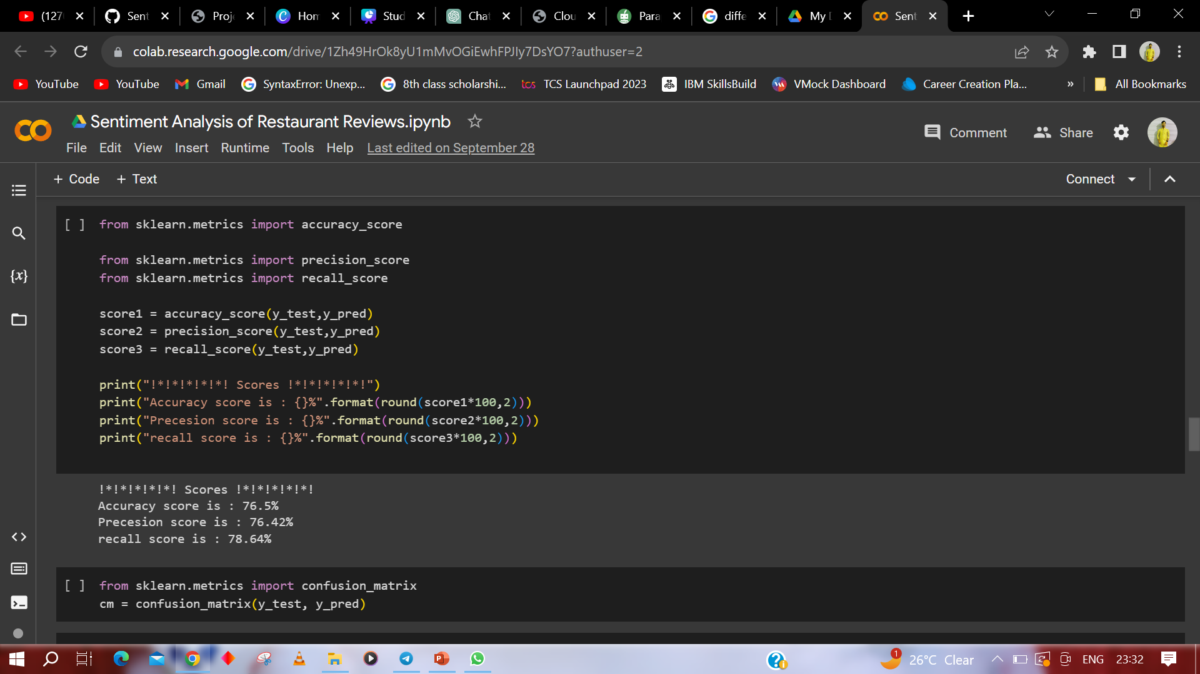
Multinomial Naive Bayes - The algorithm is a probabilistic learning method that is mostly Used in Natural Language Processing(NLP).The algorithm is based on the Bayes theorem and predicts the tag of a text such as a piece of email or newspaper article
MODELLING

Slide 11
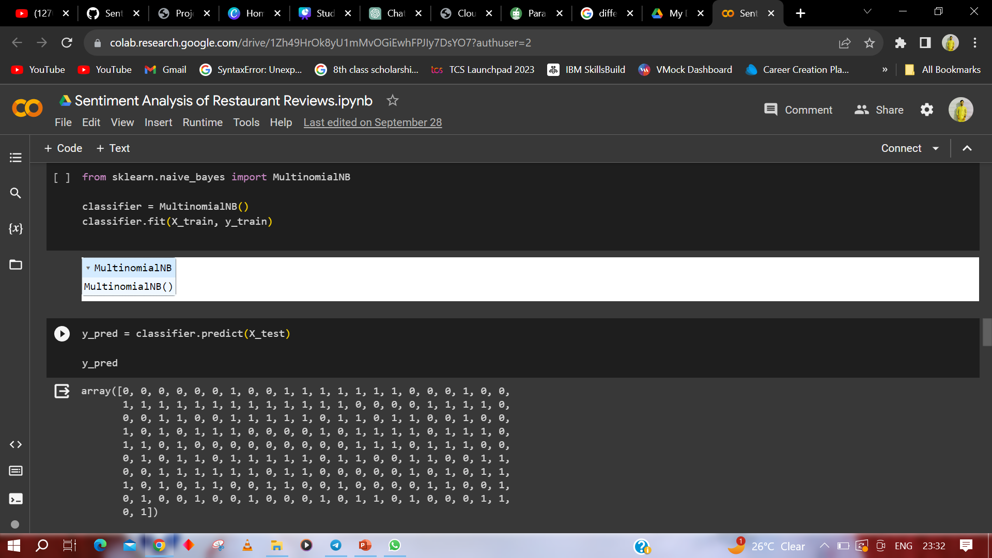

Slide 12
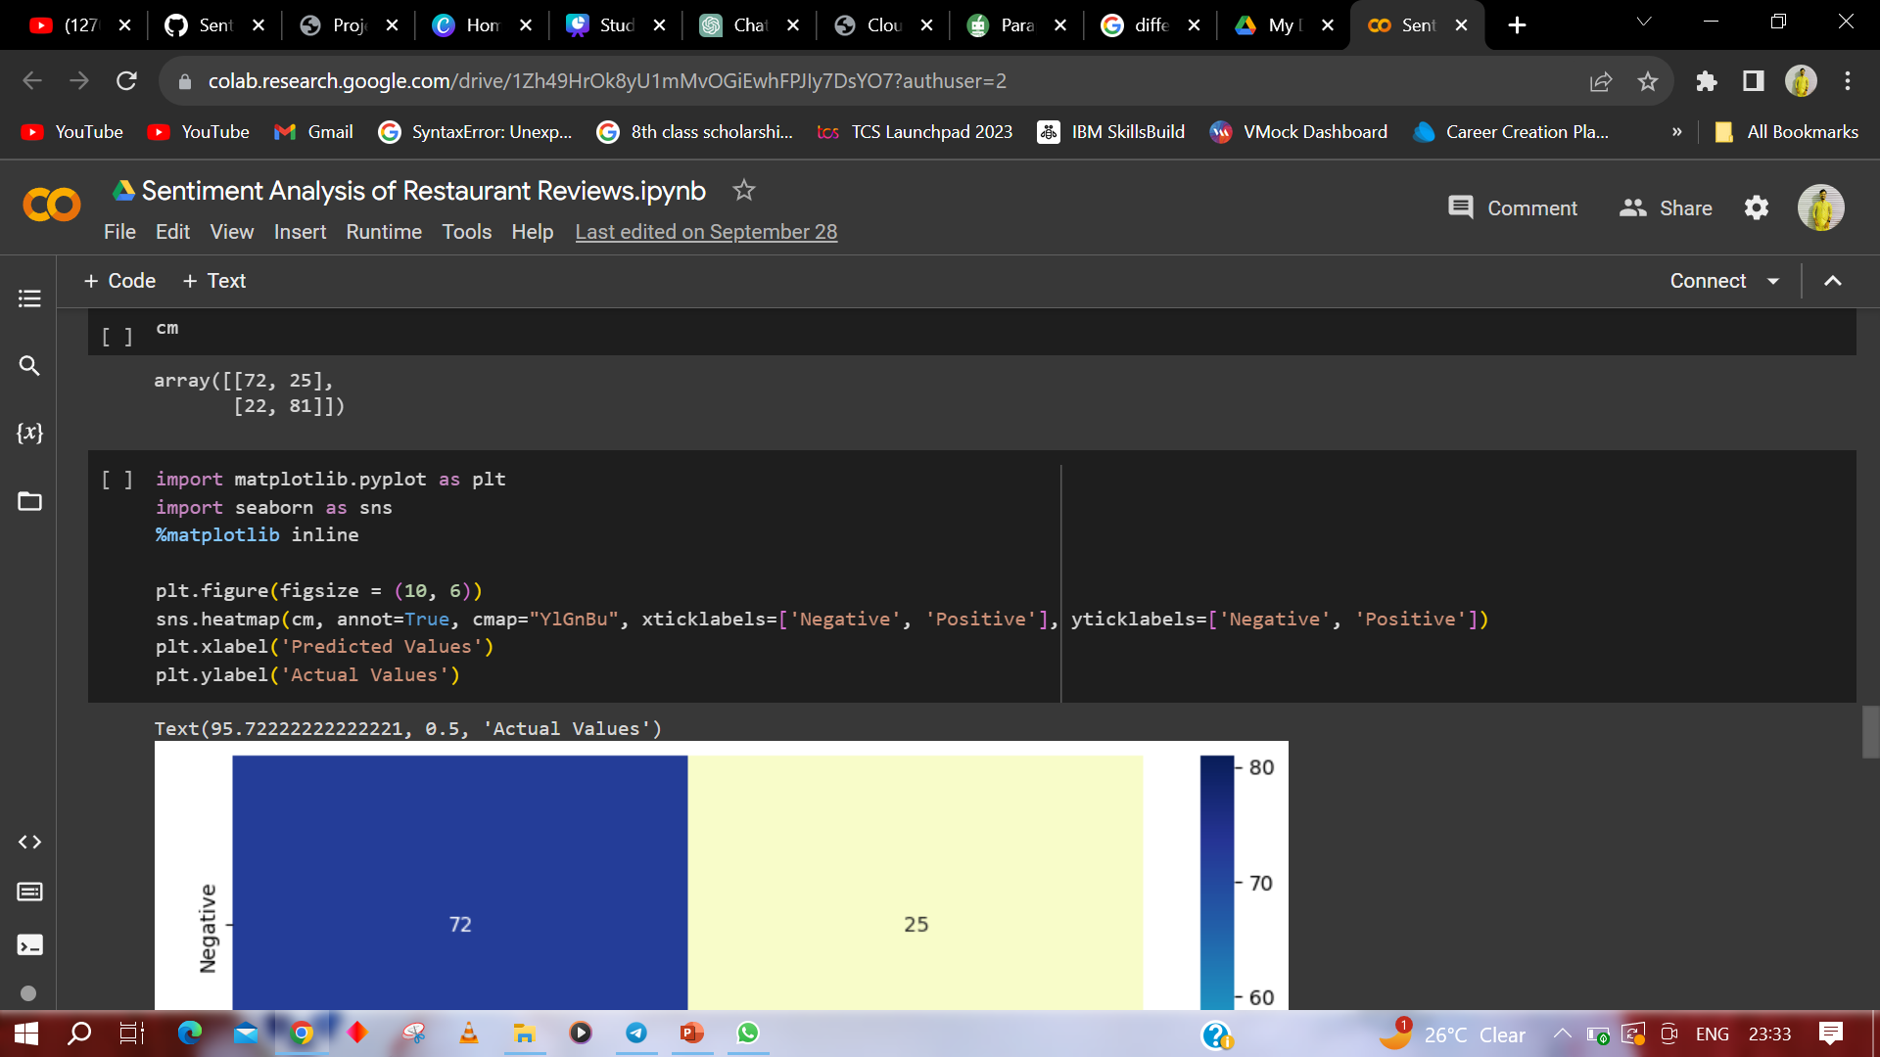

Slide 13
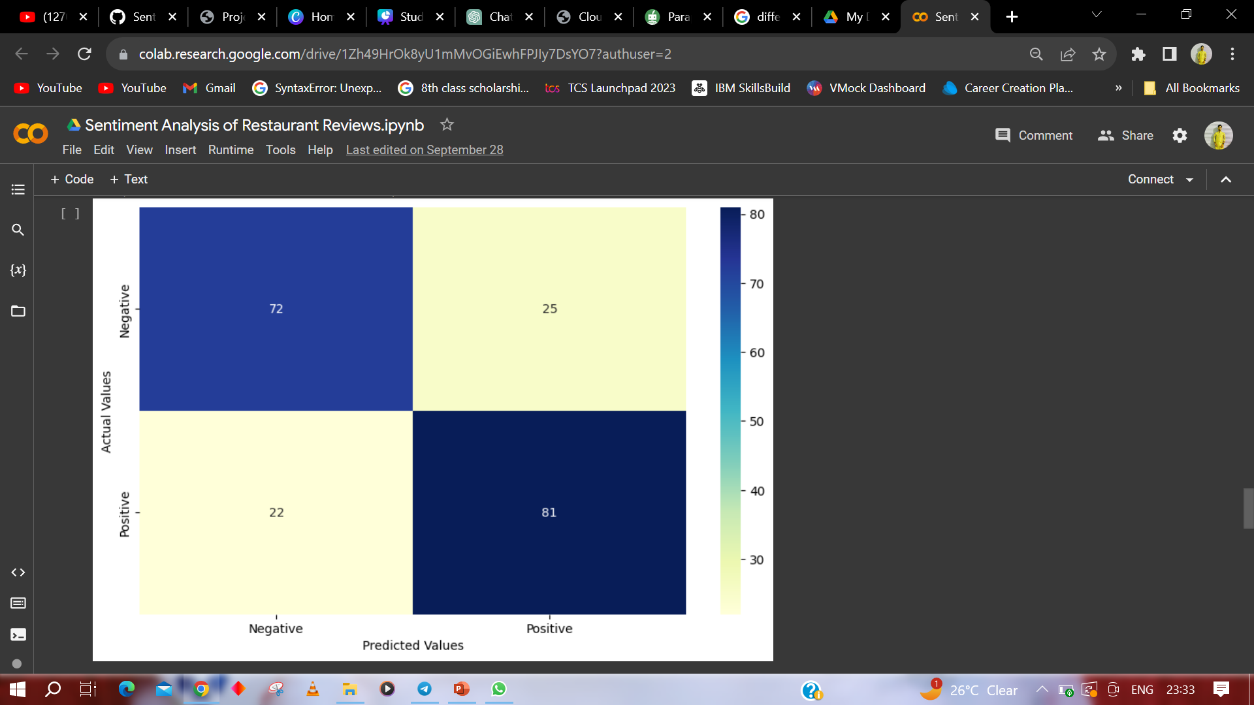

Slide 14
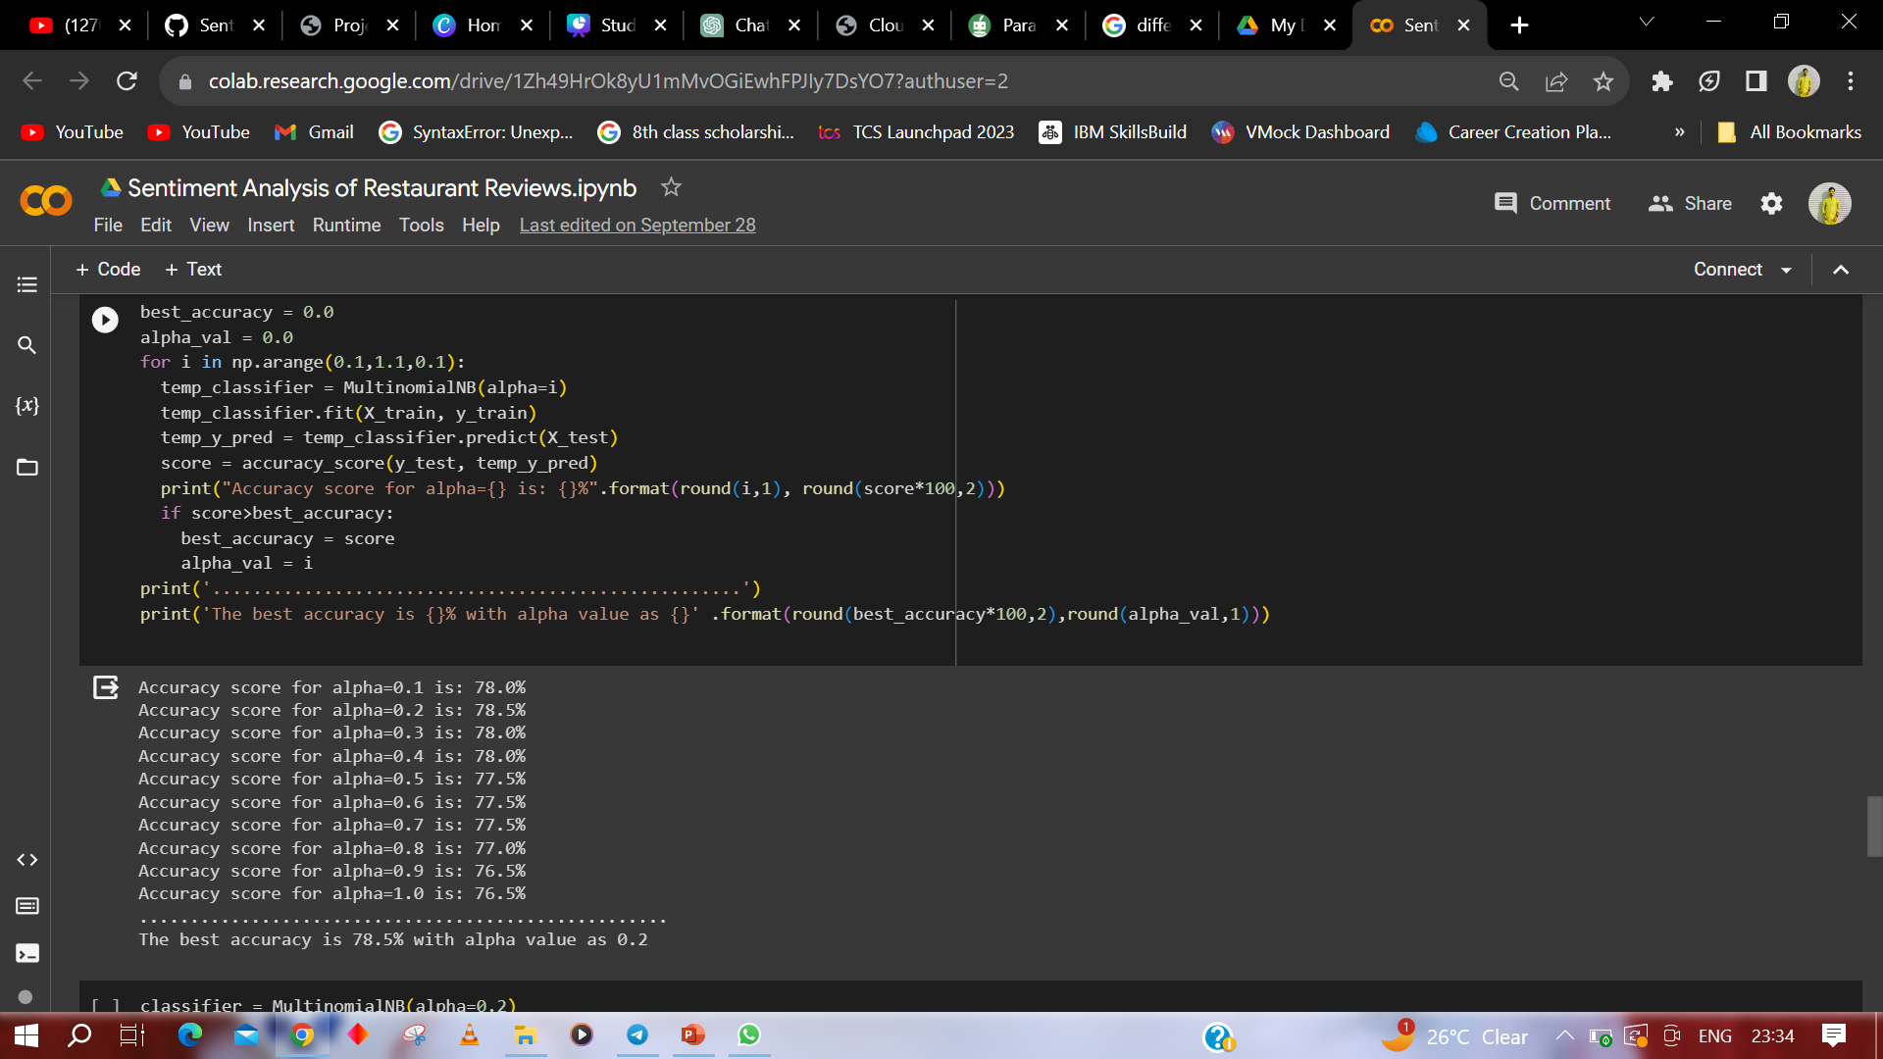

Slide 15
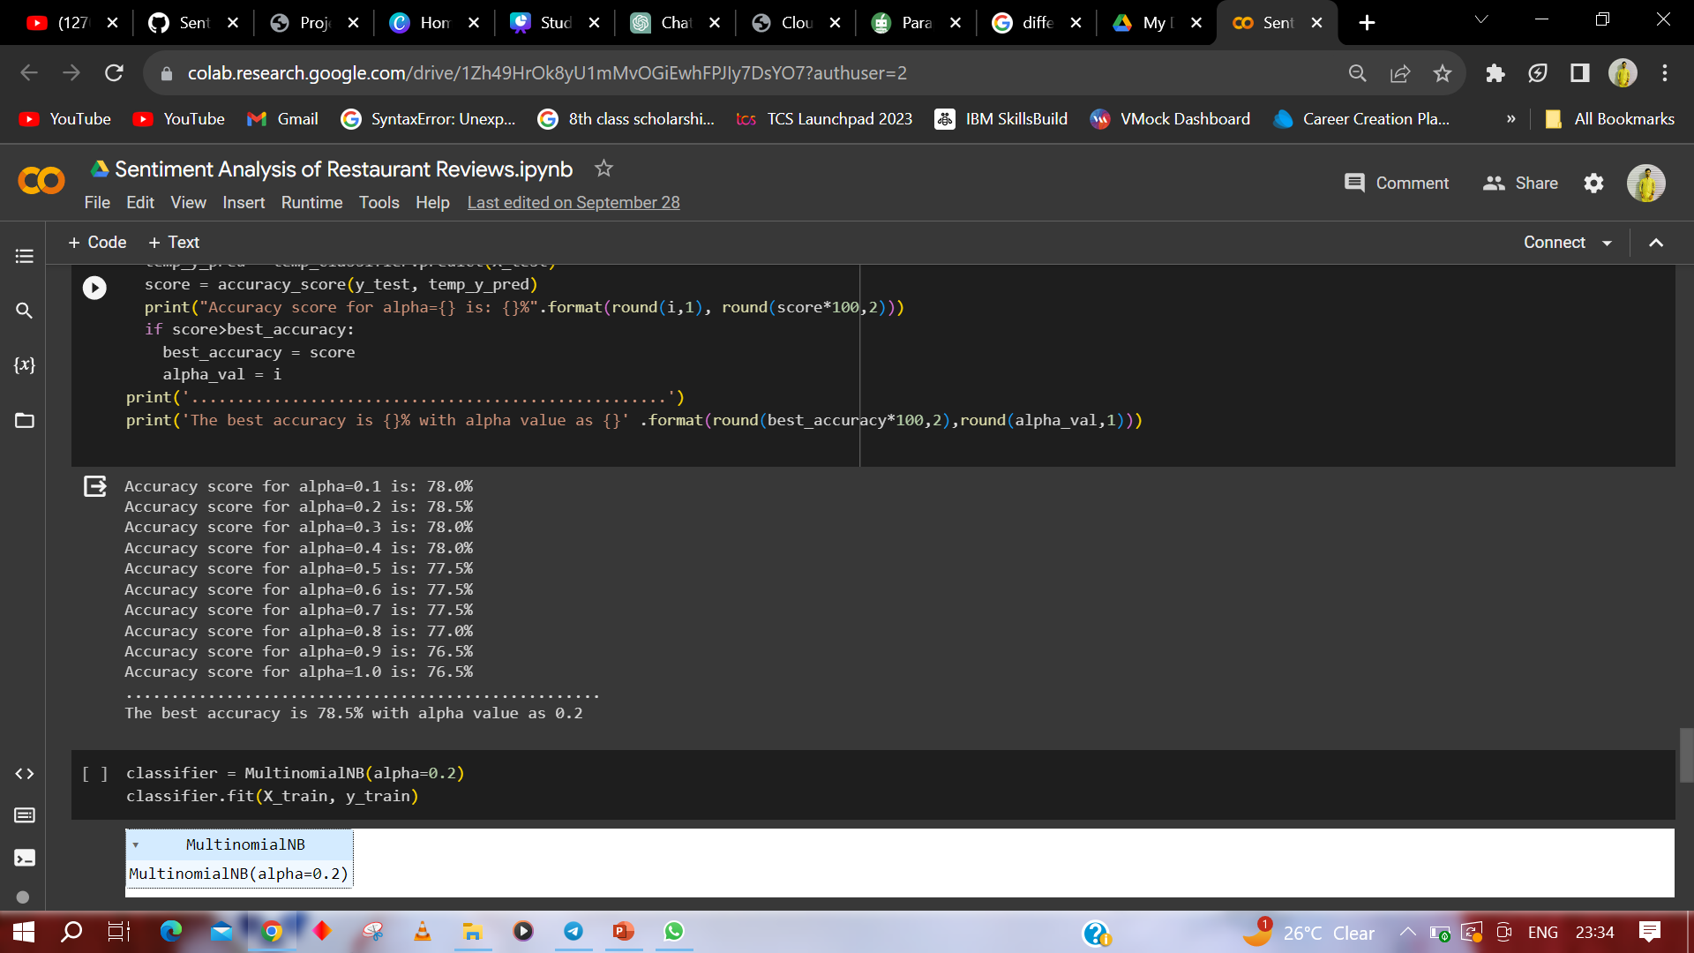

Slide 16
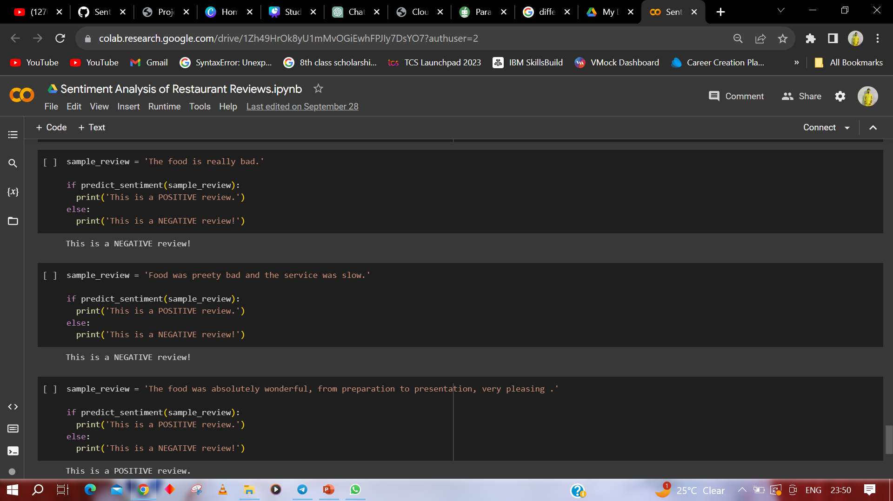
RESULTS

Slide 17

PROJECT LINK
https://colab.research.google.com/drive/1Zh49HrOk8yU1mMvOGiEwhFPJIy7DsYO7?usp=sharing
LINKS
TEMPLATE LINK
https://www.canva.com/design/DAFv1YFiLKM/7nk5nuLftw655_gEatl_pw/view?utm_content=DAFv1YFiLKM&utm_campaign=designshare&utm_medium=link&utm_source=publishsharelink&mode=preview

Slide 18

THANK YOU

